Slide 1
AI.leen
Tarlan Askaruly
Gulsim Azirakhmet
Zein Mukhanov
Computer Engineering for Engineers
Professor Mohamad Eid
Fall 2021

Slide 2
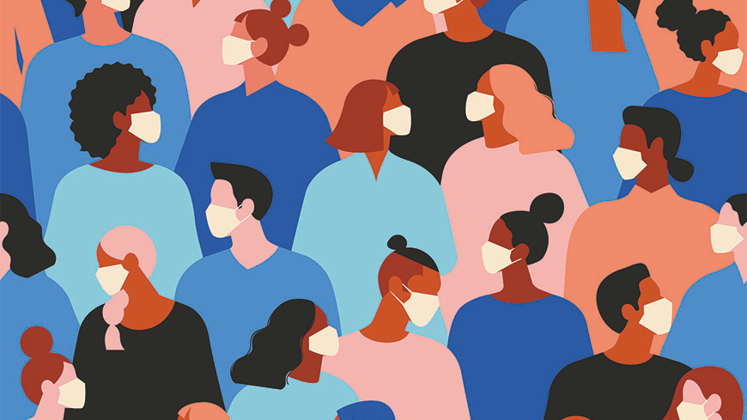
Project Rationale - Inaccessibility of medical consultants during pandemic
The pandemic has exposed problems long overlooked, including weak health systems. It also demonstrated the importance of basic public health services, strong health systems and emergency preparedness in the face of a new virus or pandemic and made it increasingly urgent to find ways to achieve universal health coverage.
Universal health coverage is defined as situation where all people and communities receive the health services they need without undue financial hardship. However, at least half of the world's population still lacks full coverage of essential health services, and more than 800 million people spend at least 10 percent of the household budget on health (WHO).

Slide 3
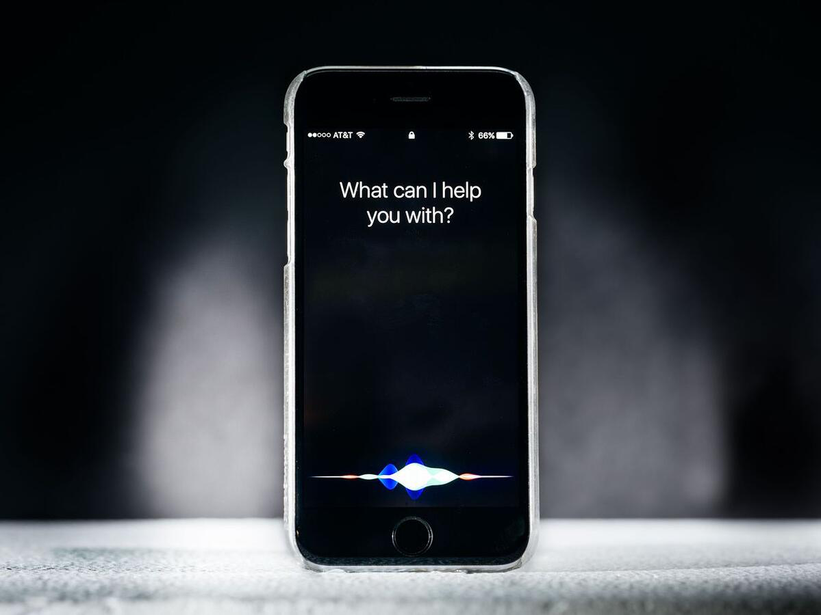
Problem definition
The difficulty of finding reliable, qualified medical professionals who are able to make a quality diagnosis of a particular disease can cause people a lot of inconvenience, because it is an important part of everyone's daily life.
Especially, with the sudden emergence of the never-before-seen COVID-19 virus, the physical communication between patients and medical workers has become limited as well as dangerous.
Therefore, a great need for high-quality, intelligent systems and virtual consultations has arisen.

Slide 4
Aims of the Project
The objective is to develop a mobile phone application with an embedded medical voice assistant, that would engage in a healthcare-related dialogue with clients autonomously, without the need for a professional physician to manage the program, answering any kind of questions related to their medical condition.
The software is going to operate in a similar way to Siri or Alexa. We want to approach this task with a natural language processing tool, specifically using a pre-trained machine learning model called GPT-3 made by OpenAI application programming interface. It is an open-source language representation model for solving text mining tasks.

Slide 5
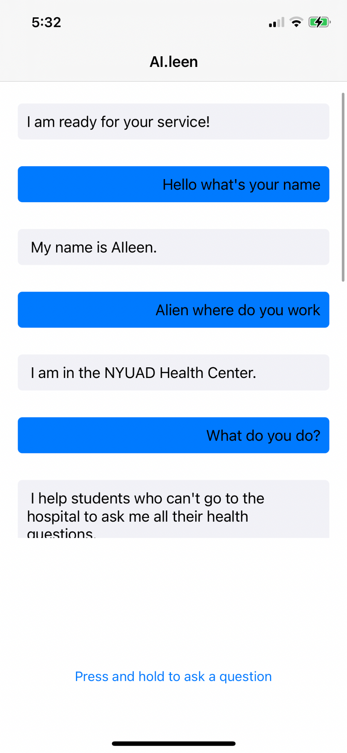
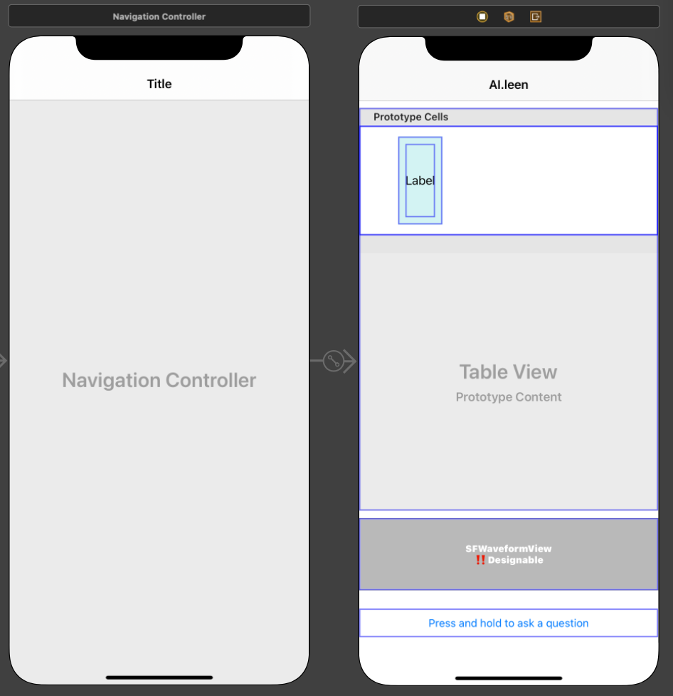
User Interface

Slide 6
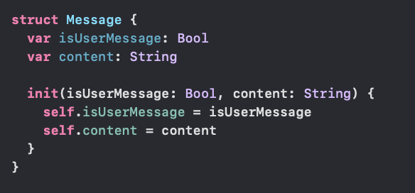
Structure that would be used to represent each message in a dialogue

Slide 7
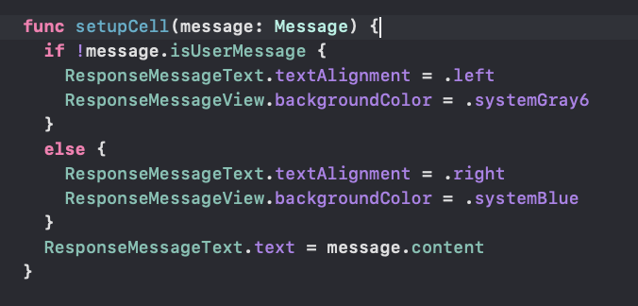
Function to set up the appearance of each message

Slide 8
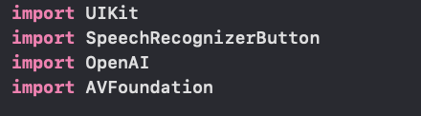
Libraries used in the program
UIKit - interface library (UI components)
SpeechRecognizerButton - button with integrated speech recognition
OpenAI - a Swift client for the OpenAI API
AVFoundation - for creating a voice response

Slide 9
Establishing OpenAI API client

Slide 10
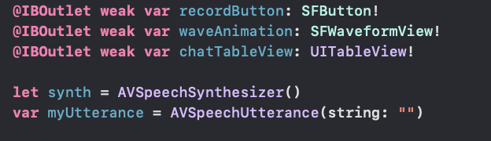
User interface elements & Audio kit

Slide 11
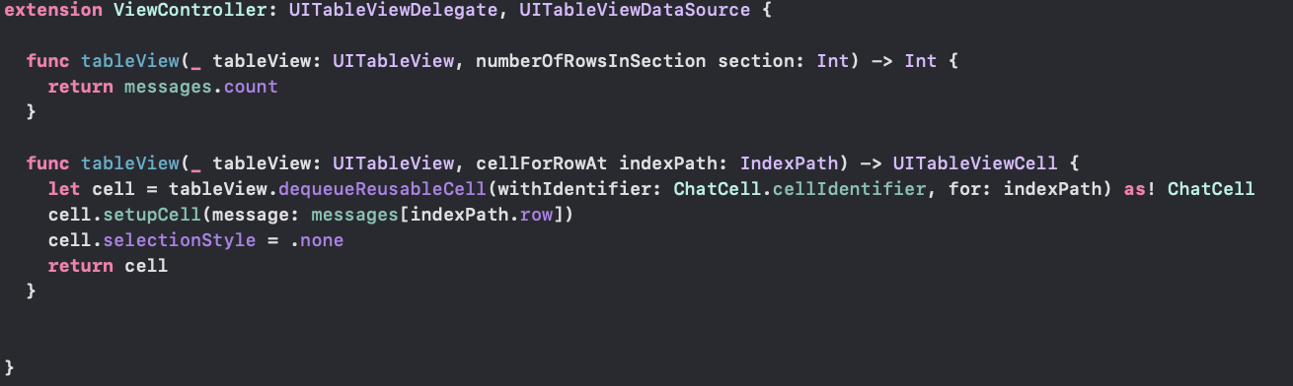
The layout of the dialogue

Slide 12
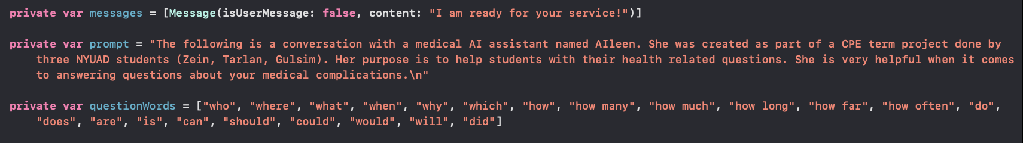
Main variables of our program

Slide 13
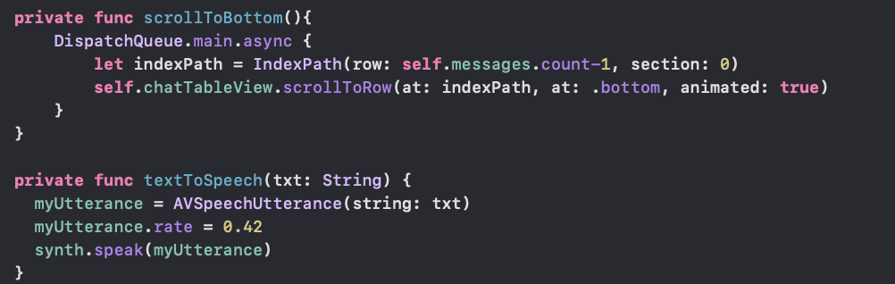
Additional functions (to scroll the table and to convert the text to speech)

Slide 14
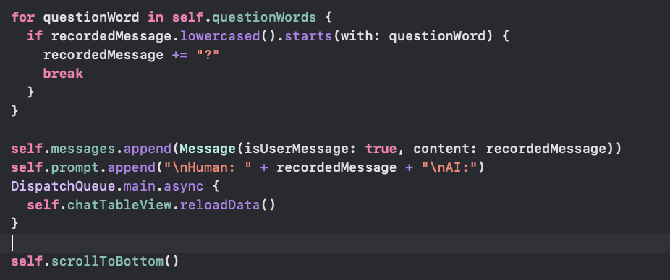
Part of the code responsible for adding the user query

Slide 15
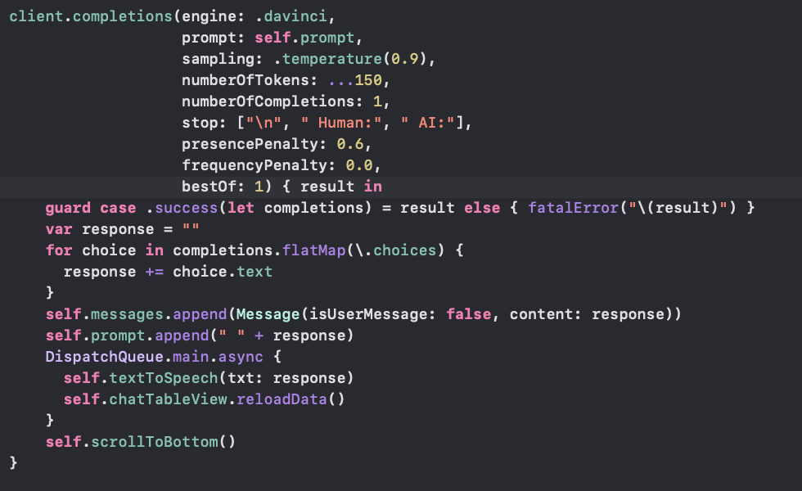
Part of the code responsible for generating and adding the AI message

Slide 16
References
“Universal Health Coverage.” World Health Organization, World Health Organization,
24 Jan. 2019,
https://www.who.int/ru/news-room/fact-sheets/detail/universal-health-coverage-(uhc).

